Slide 1
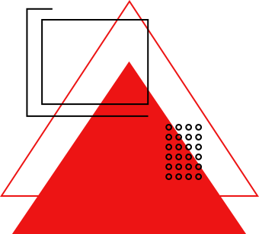
PROJECT PRESENTATION ON TABLEAU
CRIME DATA ANALYSIS
BY
ANUSHA KP

Slide 2

AGENDA
INTRODUCTION
STEPS IN CRIME DATA ANALYSIS
PROBLEM STATEMENT
ANALYSIS
CONCLUSION
REFERENCE

Slide 3

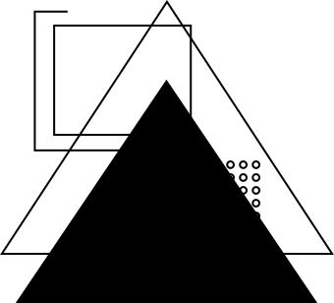
INTRODUCTION
Crime data analysis is the process of using quantitative and qualitative techniques to identify patterns and trends in criminal activity.
It can help law enforcement agencies, policymakers, and researchers make better decisions to improve public safety and allocate resources.
Crime data analysis can be used to improve criminal justice and public safety.

Slide 4
STEPS IN CRIME DATA ANALYSIS
COLLECTION
OF DATA
CATEGORIZATION
ANALYSIS
EVALUATION &REPORTING

Slide 5

INFO-DATA
Crime data of 2020 to 2024 (INDIA) has been taken for analysis and visualisation.
Backend Team of Police Department has given the csv file which contains parameters like:
* Cities where crime happened
* Date and Time of Occurence of crime
* Police deployed status for crime
* Victim Gender and Age
* Weapons used during the crime
* Cases reported year by year
*Case Closed Status

Slide 6

PROBLEMS
Major problems faced by police department is to find the top 10 cities with highest crime rates.
They need to check whether in 2024 comparing to 2020-2023 crime rate in the top cities has reduced or not.
What type of weapons are mostly used when doing crime in these cities?
Case closure rates need to be known
Higher Officials of Police deparmtment of India will be taking major decisions on the upcoming year 2025 based on this data

Slide 7
METHODOLOGY
Getting the data and cleaning
Adding Interactivity
Preparing the data for visualisation
Creation of dashboard
Analysing the Trends

Slide 8
CONCLUSION
As per the police department’s request on approaching me (Tableau Professional) solved their problems by creating visualisations on:
*Top 10 cities with highest crime rate
*Crime Trends over time
*Case closure rates by crime domain
*Victim Gender distribution
*Police deployed status
*Weapons used in crime
Finally added interactivity for the higher officials to view the crime analysis dashboard

Slide 9
Imarticus Learning
THANK YOU
By Anusha KP

